Slide 1
Automation: Set it and forget it
Databases to Dashboards
Lesson 5

Slide 2
Outline
Developing a data pipeline: data to dashboard
Scheduling tasks

Slide 3
Lesson Objectives
Apply content from previous lessons to develop a data pipeline
Schedule tasks to automate processes

Slide 4
Typical Data Science Pipeline
From R for Data Science (https://r4ds.had.co.nz/introduction.html)
Notes:
We refer to R for Data Science, a free text available online frequently
Provide a nice model for the typical process of analyzing data to communicate
Focus for this hour is the programming.
From R4DS: “You don’t need to be an expert programmer to be a data scientist, but learning more about programming pays off because becoming a better programmer allows you to automate common tasks, and solve new problems with greater ease.”

Slide 5



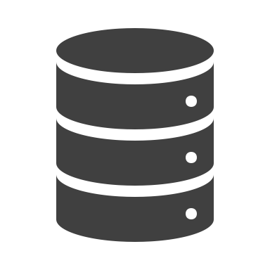

Developing a data pipeline

Slide 6
Script – read files, create dataframes
batch_file <- dir_ls("data", glob = "*_b.csv") %>%
map_dfr(read_csv) %>%
clean_names()
sample_file <- dir_ls("data", glob = "*_s.csv") %>%
map_dfr(read_csv) %>%
clean_names()
peak_file <- dir_ls("data", glob = "*_p.csv") %>%
map_dfr(read_csv) %>%
clean_names()

Slide 7
Script – write data to database tables
# initialize database connection
projectdb <- dbConnect(RSQLite::SQLite(), "project_data.sqlite", extended_types = TRUE)
dbWriteTable(projectdb, "batch", batch_file)
dbWriteTable(projectdb, "sample", sample_file)
dbWriteTable(projectdb, "peak", peak_file)
# disconnect from database
dbDisconnect(projectdb)
Notes:
# extended_types argument needed to format datetime fields
# make note about need for append or overwrite for recurring data writing of potentially same folders

Slide 8
Script – archive processed files
need these directories
dir_ls("data", glob = "*_b.csv") %>%
map(file_move(path = .,
new_path = "data/batch_archive/."))
dir_ls(path = "data", glob = "*_s.csv") %>%
map(file_move(path = .,
new_path = "data/sample_archive/."))
dir_ls("data", glob = "*_p.csv") %>%
map(file_move(path = .,
new_path = "data/peak_archive/."))
Notes:
Class will need to set up these directories in their file structure – file_move does not create directories – will get some new_path and path length don’t match

Slide 9

Developing an automated data pipeline

Slide 10
Scheduling tasks with R
cronR for MacOS and Linux
taskscheduleR for Windows
Both include RStudio Addins, which magically appear once you install the package (and its dependencies)!!
Needs TWO scripts
A. script you want to automate (i.e., does the desired work)
B. script to create the Cron or Task Scheduler job (i.e., defines schedule)
Notes:
Cron is a job scheduler on Unix-like operating systems (macOS and Linux). Users who set up and maintain software environments use cron to schedule jobs, also known as cron jobs, to run periodically at fixed times, dates, or intervals. These jobs are stored in a crontab (cron table).
Task scheduler is the Windows version

Slide 11
Syntax basics
 | taskscheduleR | cronR
Create job | taskscheduler_create() | cron_add()
Stop job | taskscheduler_stop() | ---
Delete job | taskscheduler_delete() | cron_rm()
List jobs | taskscheduler_ls() | cron_ls()
Notes:
Windows double backspace in file paths
Where does this script live?
Where do you want logs to live?
Where does R.exe live? Is default ok?

Slide 12
Example: Create a new file every minute
Part A: R script to be scheduled (does the desired work)
library(fs)
setwd("specified file path")
file_create(paste0("data/created_files/sched_test_",
format(Sys.time(), "%d-%b-%Y %H.%M"), ".txt"))
Notes:
Note about needing setwd here – cron does not respect here

Slide 13
Scheduling tasks for windows
Part B: R script to create (and remove) Task Scheduler job
library(taskscheduleR)
setwd("specified file path")
test_task < file.path(getwd(),"basic_job_file_create.R")
taskscheduler_create(
taskname = "file-create",
rscript = test_task,
schedule = "MINUTE",
starttime = format(Sys.time(), "%H:%M:%S"),
startdate = format(Sys.Date(), "%m/%d/%Y"),
days = 31)
#taskscheduler_stop("file-create")
#taskscheduler_delete("file-create")
Create new job to start now and run every minute, automating R script
Notes:
This code gets around the space in file path problem observed for Addin on Windows

Slide 14
Scheduling tasks for mac os and linux
Create new job to start now and run every minute, automating R script
Part B: R script to create (and remove) Cron job
library(cronR)
setwd ("specified file path")
test_task <- file.path(getwd(),"basic_job_file_create.R")
cmd <- cron_rscript(test_task)
cron_add(command = cmd, frequency = 'minutely',
id = "file-create", description = "test to create files",
at = format(Sys.time(), "%H:%M:%S"))
# cron_rm("file-create")

Slide 15
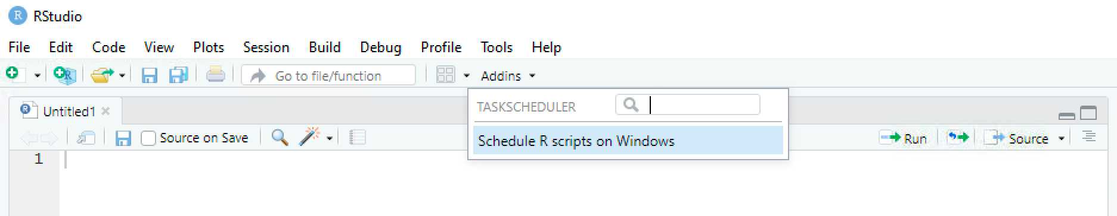
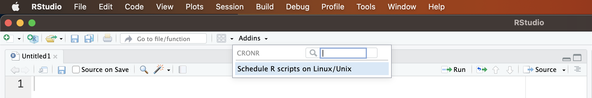
Rstudio Addins for scheduling scripts
Addins are a GUI for part B – scheduling the job

Slide 16
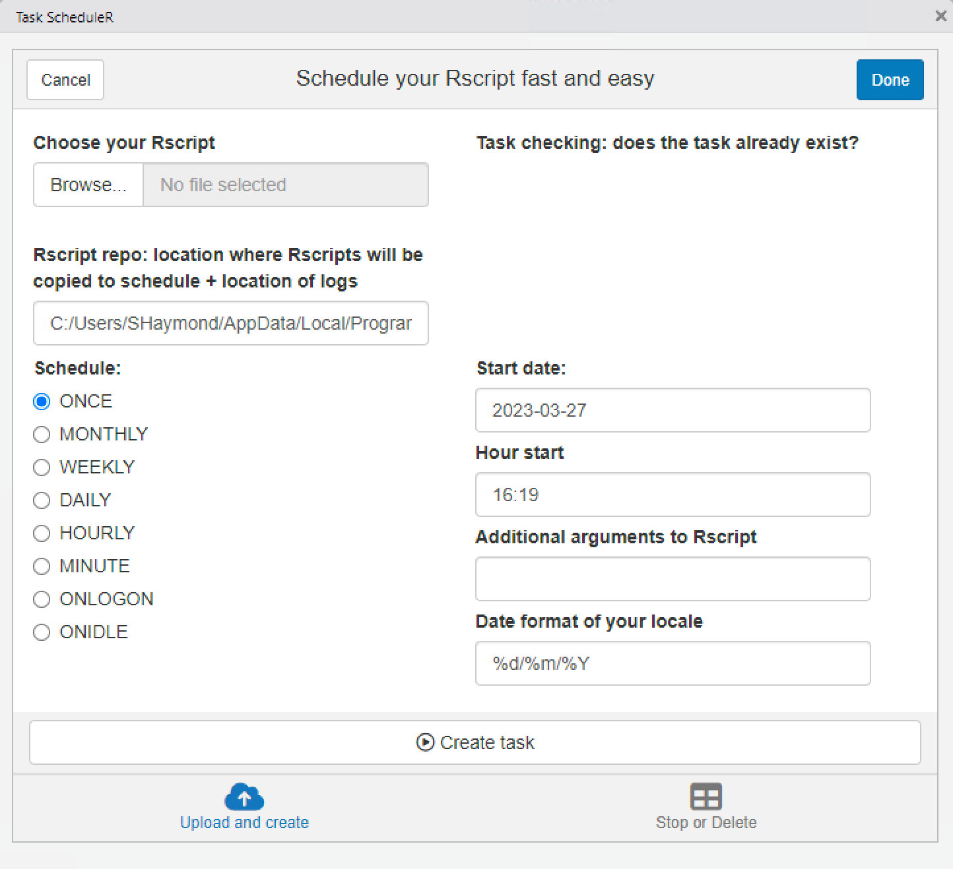
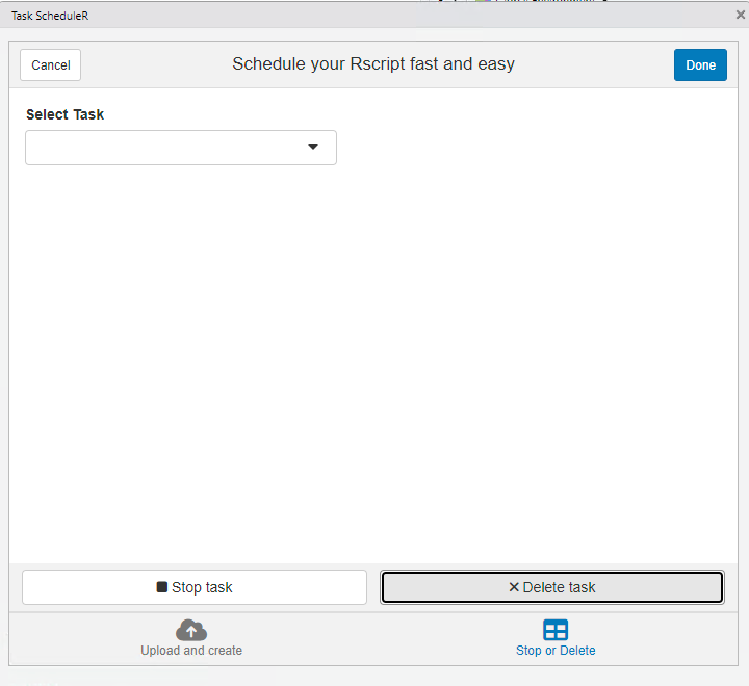
addin for scheduling on windows
file path with NO spaces
may need %m%d%Y
Notes:
Must also have access to read/write from specified repo

Slide 17
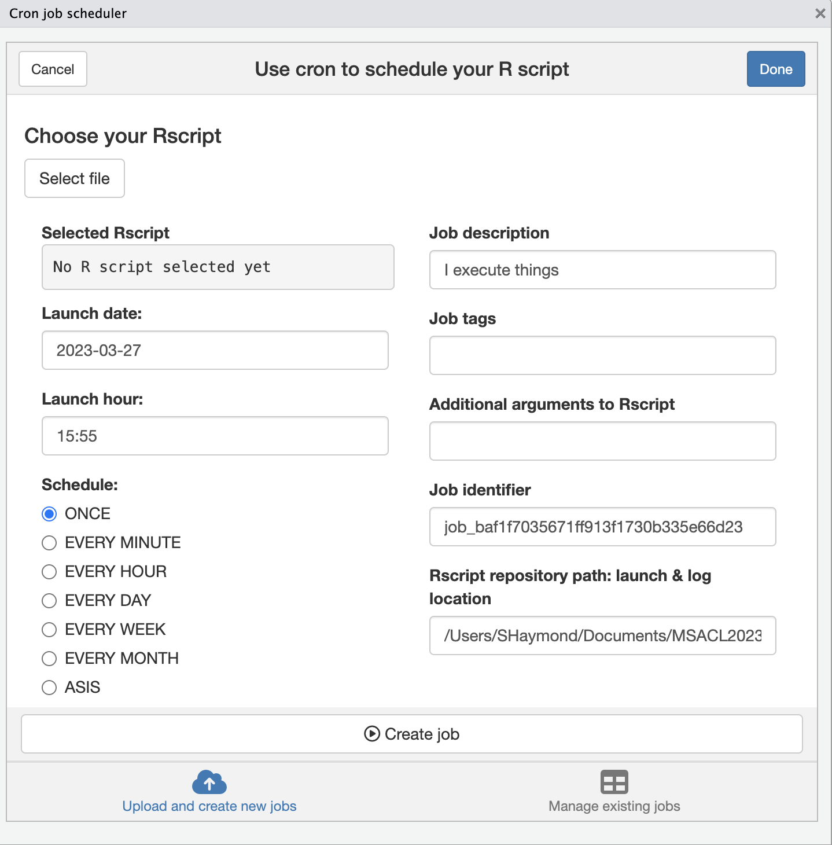
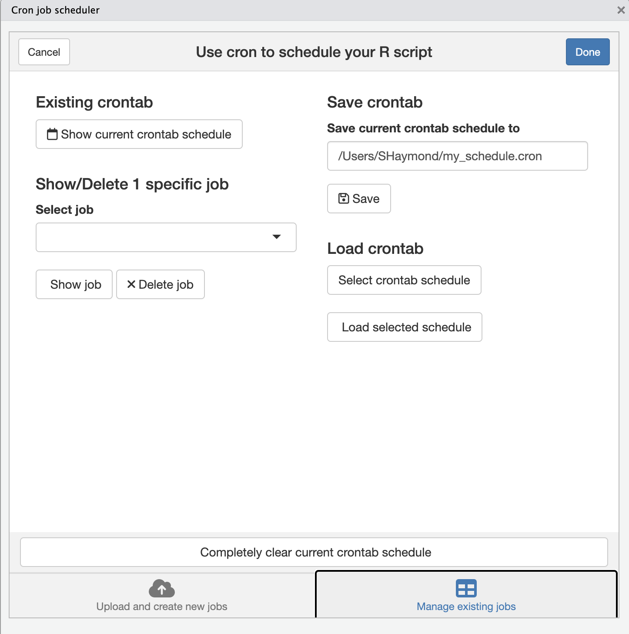
ADDin for scheduling on mac os and linux

Slide 18
Exercise 1
Use the appropriate Addin or provided script to schedule the “basic_job_file_create.R” script to run every minute starting now.
Remember to adjust the working directory to your system setup and ensure the right file structure is in place (with a created_files folder).
Windows users: confirm date format and filepath has no spaces for Addin use
Check that files are being added as expected.
Locate the job log file and inspect its contents.
Once confirmed job is scheduled as expected, use the appropriate Addin or provided script to remove the job.
Notes:
Alternative is to run the other script – either cronr or scheduler

Slide 19

Developing an automated data pipeline
run script (read_csv_files_df_write_db_archive.R) every day at 11 am, starting today

Slide 20
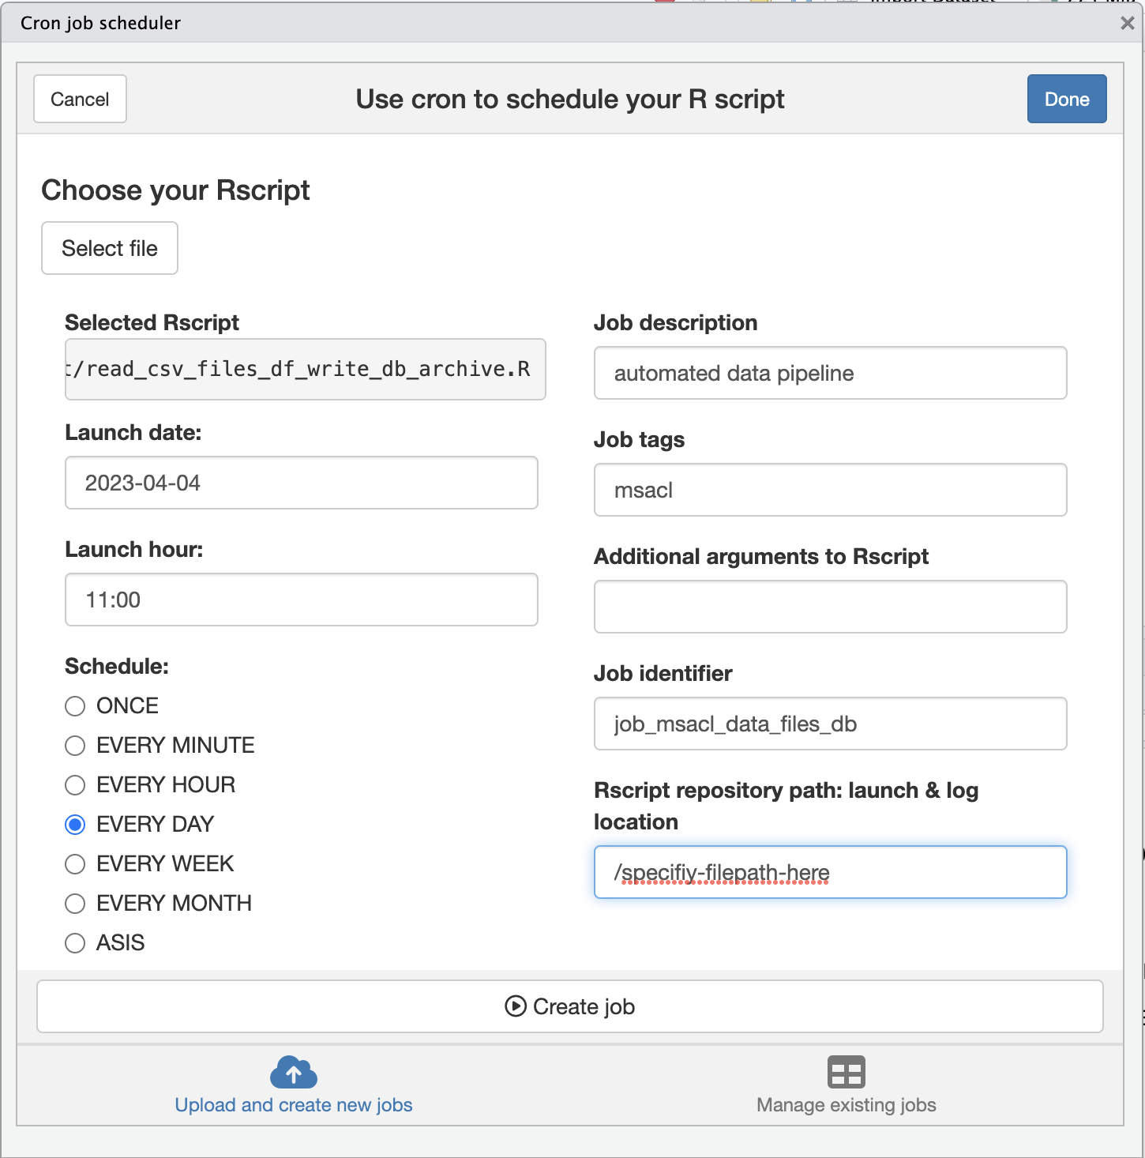
Automating our data pipeline
Create new job to start today at 11 am and run every day, automating R script

Slide 21
Exercise 2
Use the appropriate Addin or provided script to schedule the “read_csv_files_df_write_db_archive.R” script to run daily starting now.
Check that data were added to the database and files were moved as expected.
Locate the job log file and inspect its contents.
Once confirmed job is scheduled and working as expected, use the appropriate Addin or provided script to remove the job.
Notes:
Alternative is to run the scheduler code
Remember to adjust the working directory to your system setup and ensure the right file structure is in place (with the archive folders).
Windows users: confirm date format and filepath has no spaces for Addin use

Slide 22

Wow! Data would be automatically flowing into your Database each day
Now we can focus on communicating about the data with a dashboard

Slide 23
Additional considerations
Some limitations with intervals and system activity may limit utility of OS tools to schedule tasks
Scheduled tasks may be subject to security/access restrictions

Slide 24
Summary
cronR is a package that schedules tasks for Mac OS and Linux
taskscheduleR is used to schedule tasks for Windows
These packages can be accessed using Rstudio Addins
Scheduling R scripts is a useful tool for automating data pipelines

Slide 25
Lesson Objectives
Apply content from previous lessons to develop a data pipeline
Schedule tasks to automate processes

